Slide 1

Chapter 9
Experimental Designs: Within-Subjects Design

Slide 2
Within-Subjects Experiments and Internal Validity
Uses a single group of participants and tests or observes each individual in all of the different treatments being compared
Same group of individuals participates in every level of the IV.
Often called a repeated-measures design
Study repeats measurements of the same individuals under different conditions

Slide 3
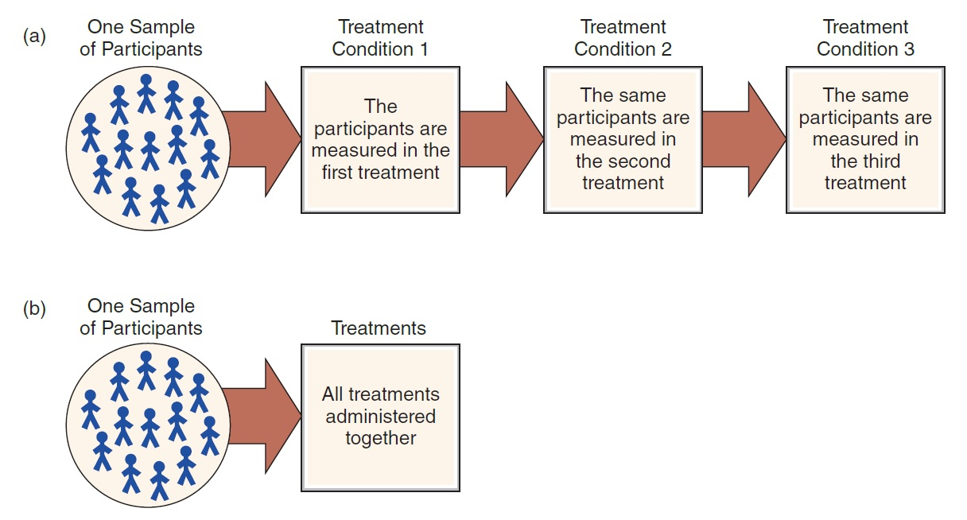
The Structure of a Within-Subjects Design
Notes:
Figure 9.1 The Structure of a Within-Subjects Design
The same group of individuals participates in all of the treatment conditions. Because each participant is measured in each treatment, this design is sometimes called a repeated-measures design. Note: All participants go through the entire series of treatments but not necessarily in the same order.

Slide 4
Threats to Internal Validity to Within-Subjects Experiments
Two major sources of potential confounding
  Confounding from environmental variables
    Characteristics of the environment may change from one treatment condition to another.
  Confounding from time-related variables
    Between the first measurement and the final measurement, participants may be influenced by factors other than the treatments being investigated.

Slide 5
Other Threats to Internal Validity
Time-related threats
  History
  Maturation
  Instrumentation
  Regression toward the mean
  Order effects (practice, fatigue, and carry-over effects)

Slide 6
Order Effects as a Confounding Variable
Order effects can produce changes in the scores (not caused by the treatments) from one treatment condition to another
Two important points
  The order effect varies systematically with the treatments ► it contributes to the second treatment, but never the first.
  The group mean shows higher scores in second treatment.

Slide 7
Dealing with Time-Related Threats and Order Effects
Controlling time
  The possibility of a time-related threat (e.g., history or maturation) is directly related to the length of time required to complete the study.
  Shortening the time between treatments increases the likelihood that order effects will influence results.
  Increasing the time between treatments increases the risk of time-related threats to internal validity.

Slide 8
Counterbalancing: Matching Treatments with Respect to Time
Counterbalancing: changing the order in which treatment conditions are applied from one participant to another
  Matches treatment conditions with respect to time
  Goal: to use every possible order of treatments with an equal number of subjects participating in each sequence
  Purpose: to eliminate time-related confounding

Slide 9
Counterbalancing and Order Effects
Counterbalancing a within-subjects design prevents any order effects from accumulating in one particular treatment condition.
  Spreads order effects evenly across all the different conditions ► allows a fair, unbiased comparison between treatments
  Does not eliminate the order effects

Slide 10
Limitations of Counterbalancing
Counterbalancing and variance
  Counterbalancing does not eliminate order effects, which can result in distortion of the treatment means.
    Adds the order effects to some of the subjects within each treatment, but not to all
Asymmetrical order effects
  The order of treatments does not balance the order effects.

Slide 11
Counterbalancing and the Number of Treatments (1 of 2)
Complete counterbalancing requires presenting the treatments in every possible sequence.
  This is easy with only two treatment conditions; becomes more complex as the number of treatments increases.
Partial counterbalancing
  Each treatment condition occurs first in the sequence for one group, occurs second for another group, etc.

Slide 12
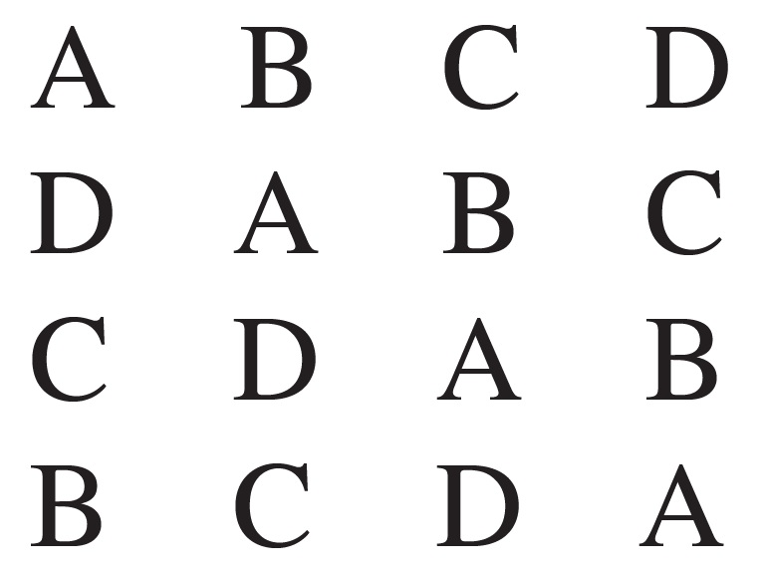
Counterbalancing and the Number of Treatments (2 of 2)
In partial counterbalancing, a Latin square can be constructed to decide which sequences to select.
Four Conditions
Participant 1
Participant 2
Participant 3
Participant 4

Slide 13
Why Choose Repeated Measures?
Advantages of within-subjects design
  Requires relatively few participants
  Eliminates problems based on individual differences
  Reduces variance
    Increases the chances of detecting a treatment effect

Slide 14
Advantages of Within-Subjects Design
A within-subjects design:
  Has no individual differences between groups; there is only one group of participants
  The group in one treatment is exactly the same as the group in every other treatment.
  Result: no individual differences between groups to confound the study
    Each subject appears in every treatment condition.
    Each subject serves as his or her own control.

Slide 15
Disadvantages of Within-Subjects Designs
Each participant usually goes through a series of treatment conditions, often with each treatment administered at a different time.
  May lead to time-related factors which influence the subjects’ scores
Participant attrition: some of the subjects who start the study will drop out before the study is completed

Slide 16
Choosing Within- or Between-Subjects
Advantages of within- and between-subjects designs are essentially the same as the disadvantages of the other.
Three factors that differentiate the designs:
  Individual differences
  Time-related factors and order effects
  Fewer participants

Slide 17
Matched-Subjects Designs
Uses a separate group for each treatment condition
Each individual in one group is matched one-to-one with an individual in every other group.
  Matching is based on a variable that is particularly relevant to the specific study.
  Goal: to duplicate all the advantages of within- and between-subjects designs without the disadvantages of either one

Slide 18
Applications and Statistical Analysis of Within-Subjects Designs
Two-treatment designs
  The simplest application of a within-subjects design is to evaluate the difference between two treatment conditions.
    With data measured on an interval or ratio scale, data analysis requires using a repeated-measures t or a single-factor ANOVA (repeated measures).

Slide 19
Multiple-Treatment Designs: Advantages
Data are more likely to reveal the functional relationship between the two variables.
Produces a more convincing demonstration of a cause-and-effect relationship than a two-treatment design

Slide 20
Multiple-Treatment Designs: Disadvantages
Researcher may create too many treatments.
  The distinction between treatments may become too small to generate significant differences.
May increase attrition if more time is required of participants
Counterbalancing is more difficult as number of treatments increases.

